Slide 1
Welcome & Induction
DENT1060: Dental Practice IA
Course Coordinator: Dr Thomas Kim 2025

Slide 2
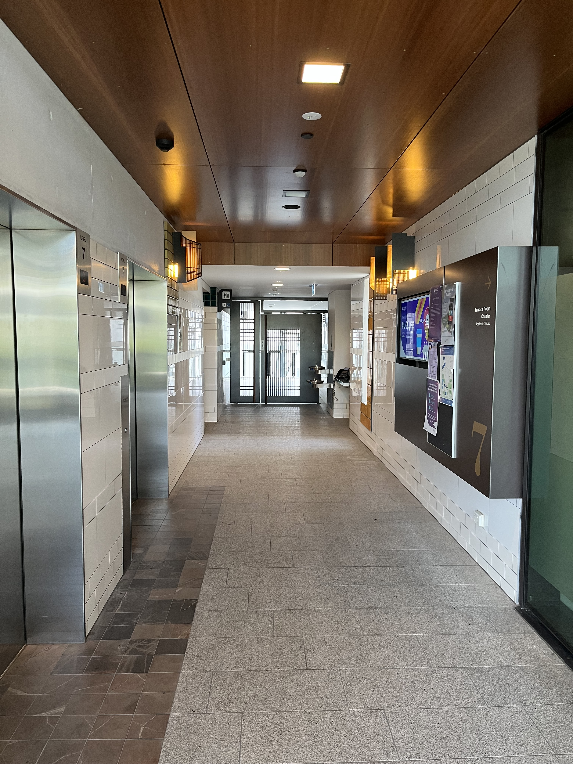
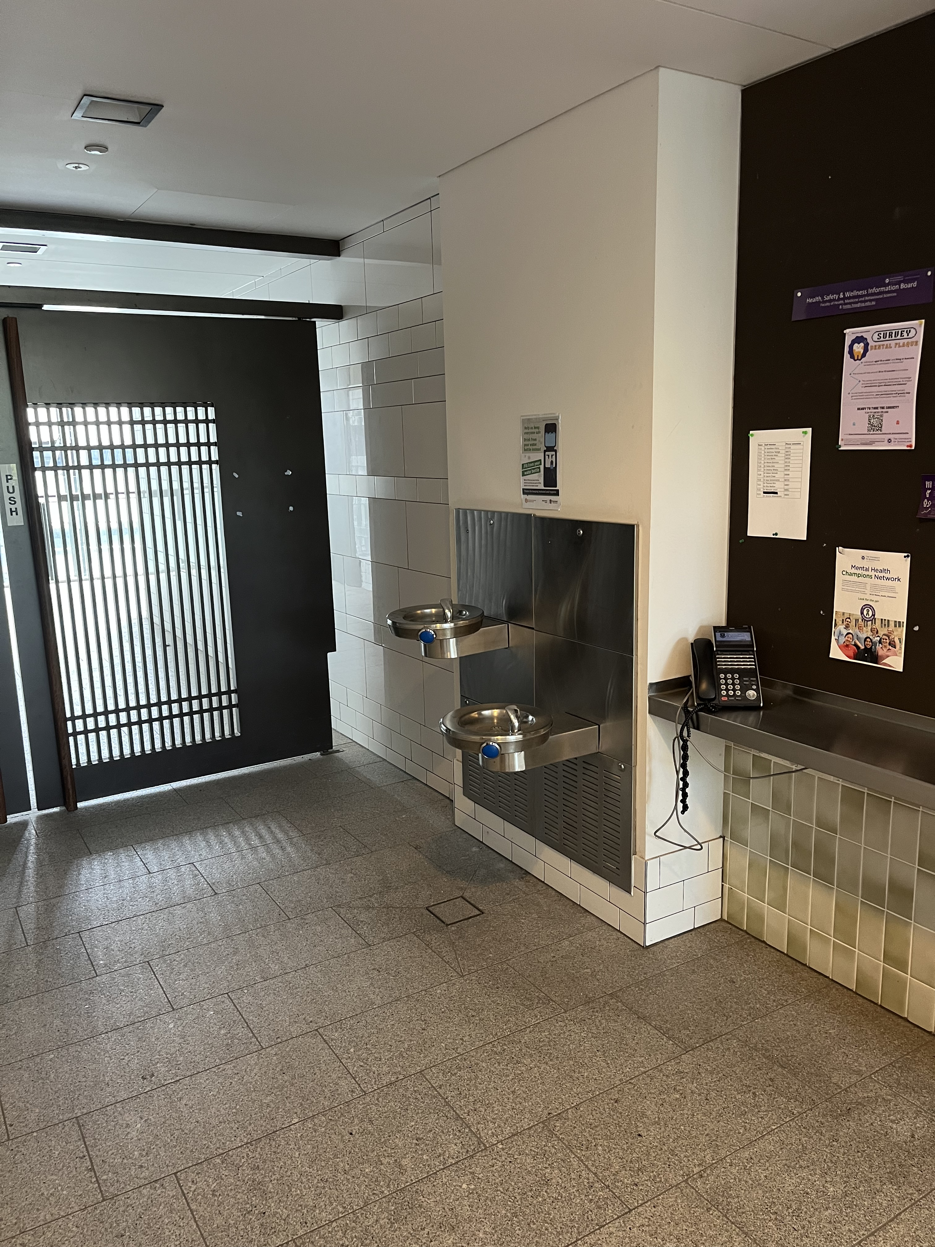
Contacting me
I am located in Level 7 of the Oral Health Centre. Accessing into this space requires prior notice to me.
Usual days of work
Wednesday, Thursday, Friday
Contact point
Thomas.kim@uq.edu.au
If at any stage, you have any concerns or matters you wish to discuss with me privately (outside of scheduled course hours), please email me and we can organise a time for discussion

Slide 3
What is dentistry (to you)?

Slide 4
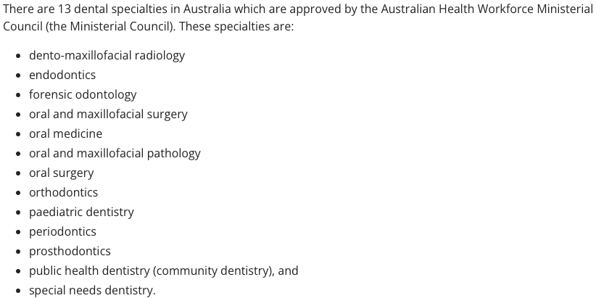
What fields of dentistry are there?
There’s also other fields in dentistry
General dentistry!
Research
Public dentistry (working in hospitals)
University positions
Consultant positions (E.G. dento-legal consultant)
My best advice to you is…
Be open minded and look into each of these fields and EXACTLY what skills/roles they require

Slide 5
How do you decide what you want to do?
You can’t!
You can try plan your future as best as possible, but this is 5years, and you need 2~5years of experience to actually know if you enjoy your work field
My personal 2 cents
UQ generally hosts new/recent graduate dentist panel (usually for 3rd/4th/5th years)
Attending it can you give a very good and real perspective of how wide the Dental field is
Give “some” attention to your lecturers/supervisors journey through dentistry
There’s various ways to reach where you want to be
There’s also a recipe of success for many of these pathways

Slide 6
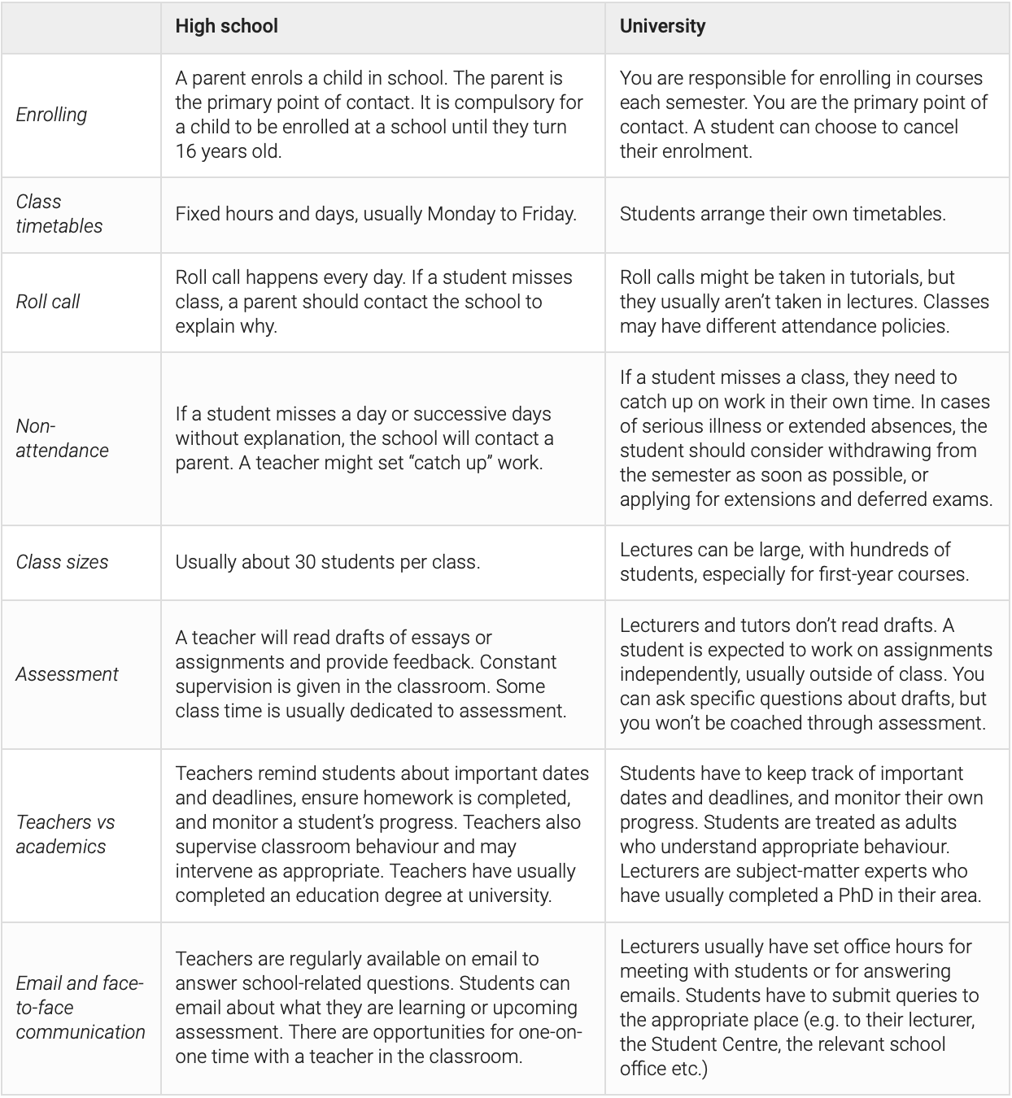
Learning to transition from High School/non-health degree to Dentistry
Whilst, yes, University will still provide marking criteria for assessments, guidelines for performance, etc…
Dentistry has a strong expectation that you self-identify and nurture your growth
UQ Dentistry staff are here to help provide guidance and perspective
The faster you can come to appreciate this, the better you can thrive!

Slide 7
DENT1060 course learning objectives
1. Understand effective communication techniques to facilitate person-centred dental practice.
2. Demonstrate an emerging critically reflective approach to dental practice.
3. Describe the anatomy of the primary and permanent dentition.
4. Manage and maintain a safe working environment, including principles of ergonomics.
5. Conduct and record a thorough patient interview to collect relevant medical, dental and social information.
6. Understand the ethical principles and legal responsibilities involved in the provision of person-centred dental practice.
7. Understand the principles of prevention of diseases in the oral cavity.
Course learning objectives and lecture learning objectives are different!

Slide 8
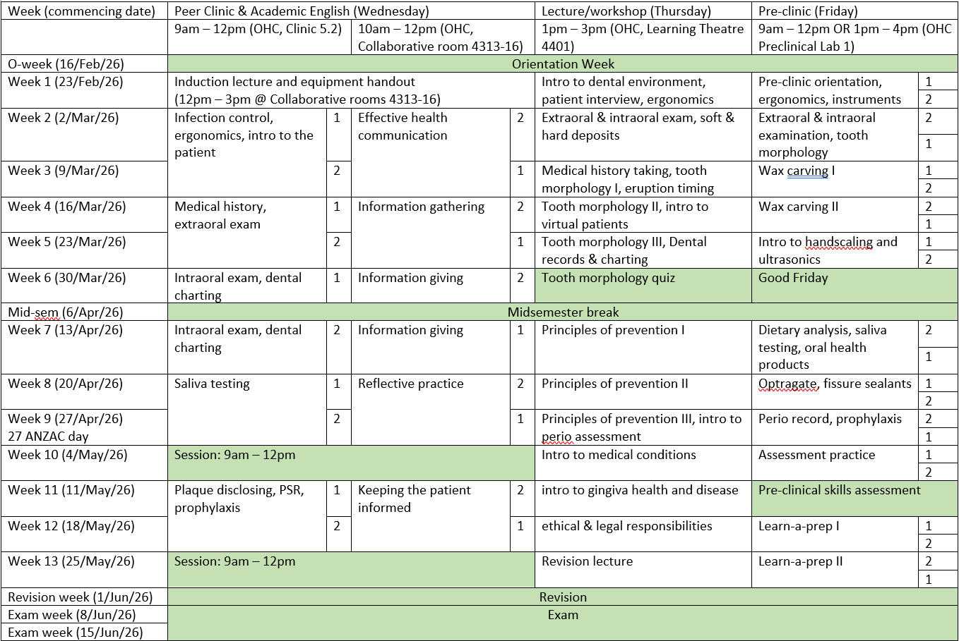

Slide 9
Understanding the schedule
Clinical coaching -> your lecture content
Supplemented with online learning
You are expected to do any recommended readings and pre-requisite learning prior to each lecture (lecture slides are available the week prior)
Pre-clinic -> simulation laboratory sessions
You will be developing all modes of practical skills in these classes, and you can only see patients for the relevant skills once you pass the assessments linked to the noted skills
Peer-clinic -> simulation patient clinic sessions
You will be learning to transfer your practical skills to real patients (role played by your colleagues)
English Academic Communication class -> no you are not learning how to speak English in this class
Technical and health-related communication skills related to critical information collection, interpretation, and delivery

Slide 10
Attendance expectations:
The School of Dentistry attendance guideline details requirements for attendance:
The Pre-clinical and Clinical Learning activities are designed to ensure that students receive the required level of patient exposure to achieve the Program Learning Outcomes.
100% attendance is required over the semester
Concerns regarding absences from any Pre-clinical/Clinical Learning will be considered on a case-by-case basis as to whether the student meets the requirement to pass the course.
Arriving late: Arriving more than 15 minutes late without a valid reason (i.e. unforeseen circumstances) will result in an absent on your record.

Slide 11
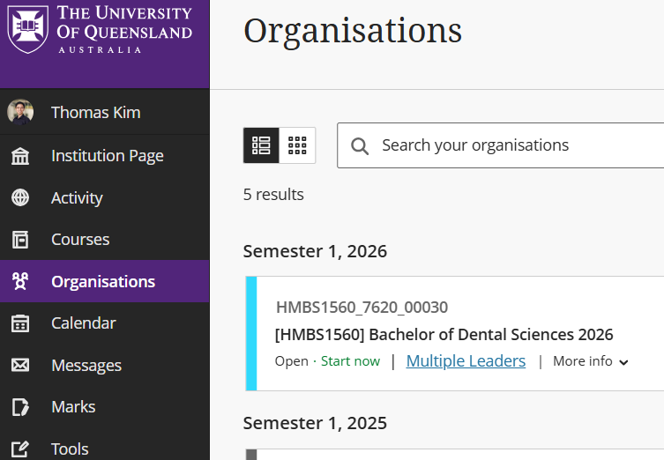
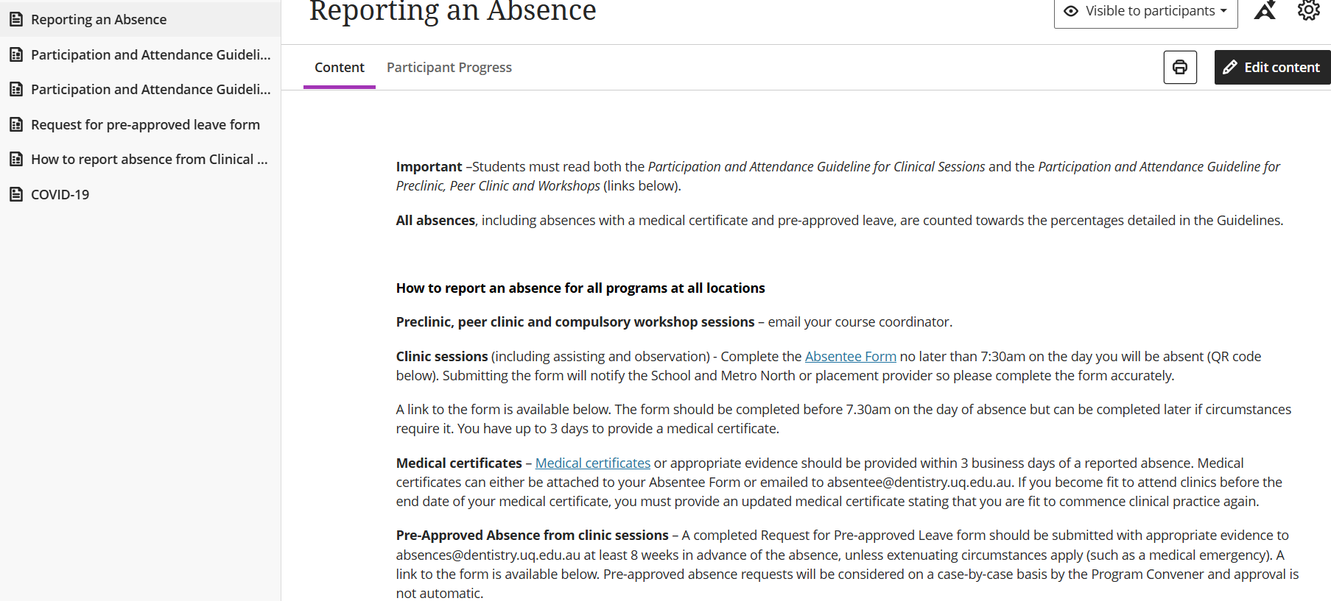
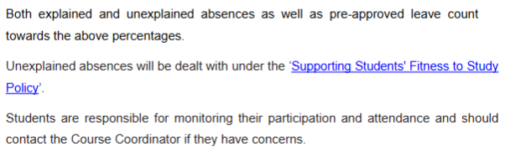
Absence and more information on Blackboard
Take note, any reporting of absence or request for pre-approval are directly to me at 1st year level.
You do not need to report to SAS for 1st year.

Slide 12
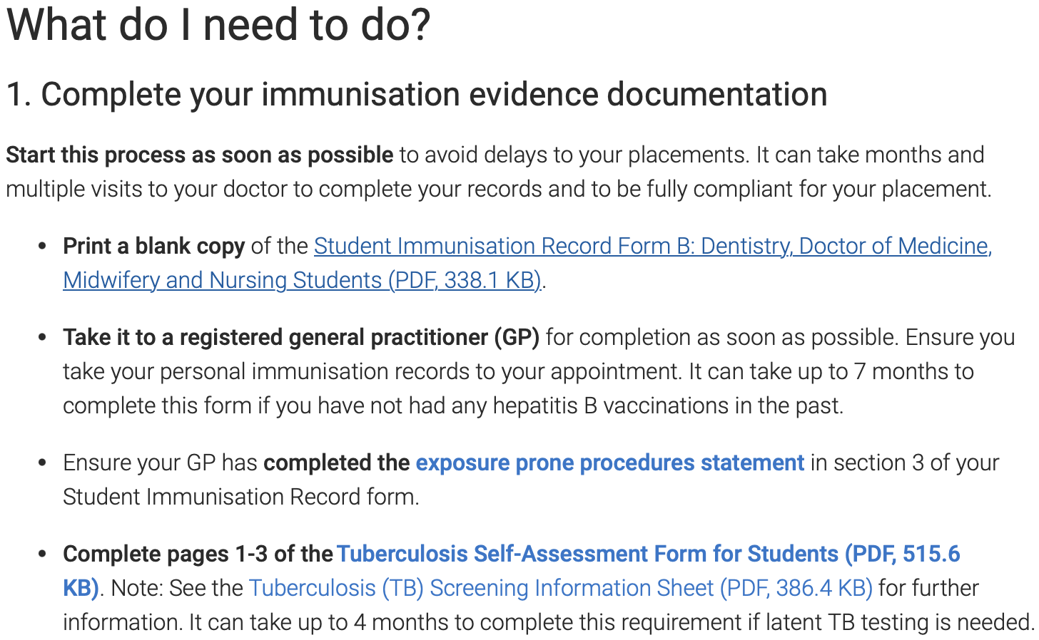
Immunisation!
https://my.uq.edu.au/information-and-services/manage-my-program/immunisation-and-disease-screening/student-immunisation-requirements/dentistry-medicine-midwifery-nursing
You can also search “UQ dentistry immunisation” to find the above weblink
Ideally, you should have already actioned/begun action on this
It is your responsibility to meet the expectations of immunisation
Barred entry to Peer clinic due to improper immunisation standard counts as an absence

Slide 13
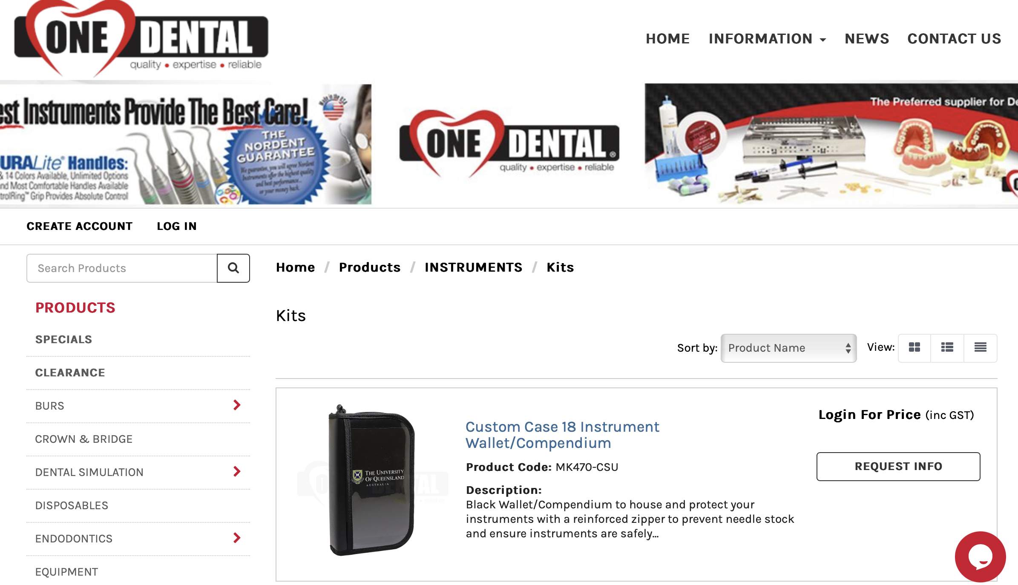
Equipment purchased for pre-clinic:
You should have picked up your equipment this morning!
Anyone who is still waiting on their equipments do not fret as there is still time…
You can find more equipment on the One Dental site

Slide 14
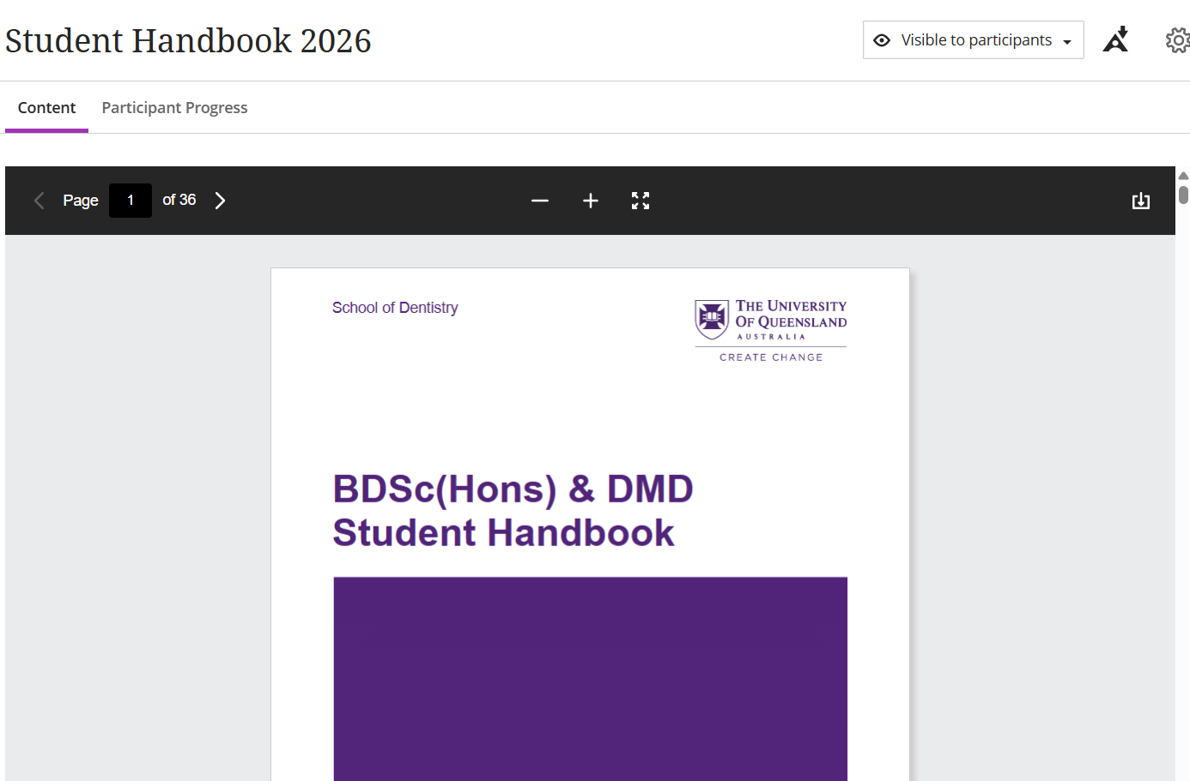
Please have a read through the Dentistry handbook!

Slide 15
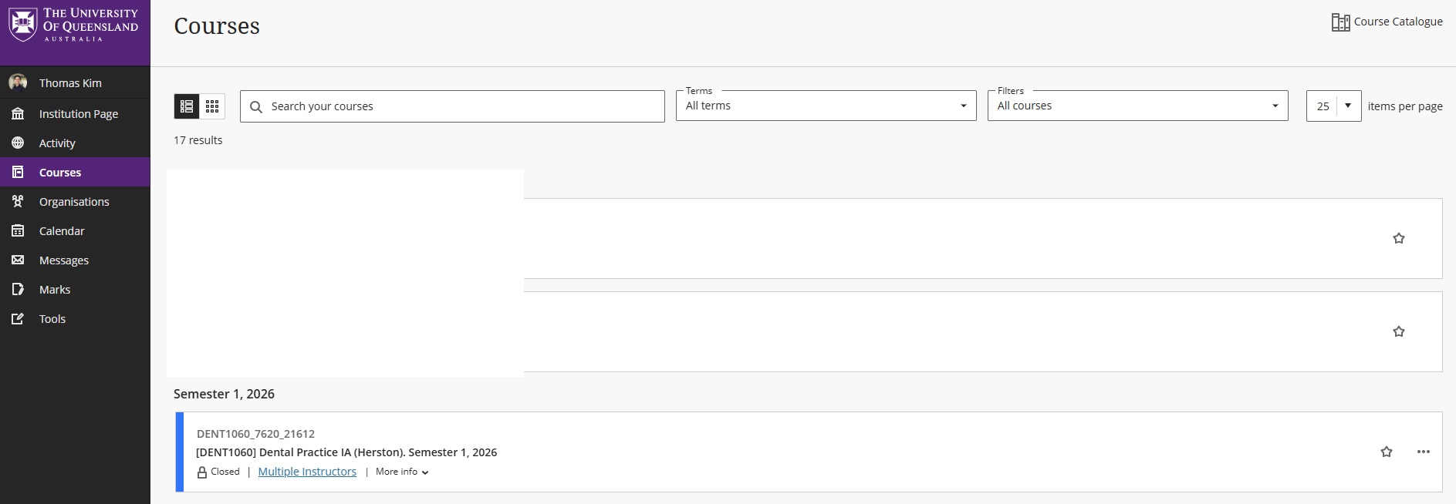
Accessing Blackboard…
When accessing DENT1060, be sure these are selected

Slide 16
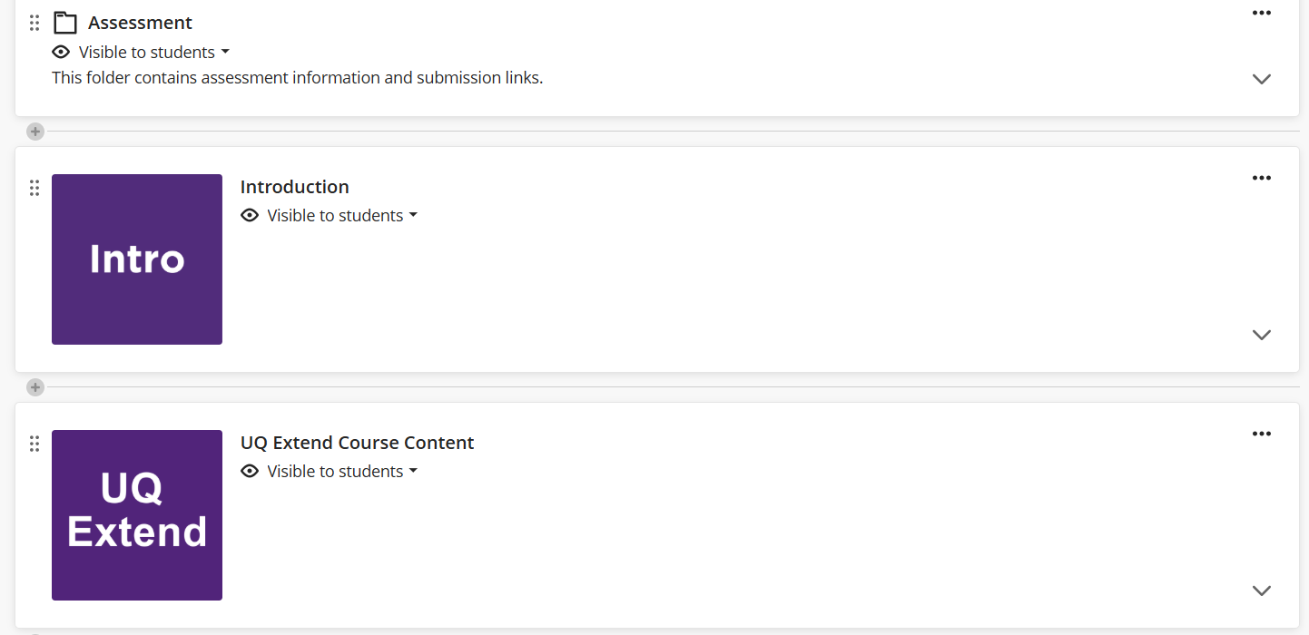
Learning to use Blackboard…

Slide 17
Locker Keys:
Lockers and your locker keys will be assigned to you ASAP through SAS!
So please be patient and work with us on it!
You will collect your keys from the SAS office when it’s ready
You will receive an email regarding this arrangement closer to the day of collection
Speaking from experience of losing the key 2 times…
Please do not lose it!
You cannot create a copy of the key, so you need to pay for replacement!

Slide 18
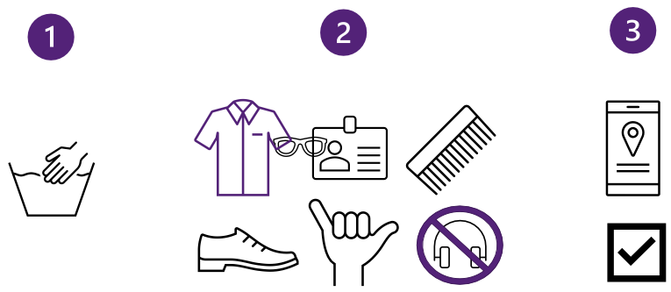
DENT1060 Peer & Pre - clinics
Be dressed appropriately and/or professionally
Shoes need to be fully enclosed, non-porous, leather-type
Please wear your name tag at all times!
Bring your safety glasses, equipment, workbook, and a pen
Also, you will be assigning yourselves to your own seats in Pre-clinic, and forming groups of 3 for Peer clinic!
Some exceptions apply with seating arrangements, but this will be clarified on relevant days

Slide 19
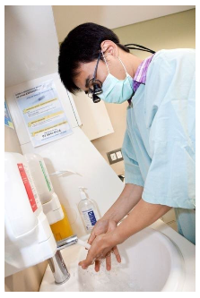
Bare below the elbows
Things not allowed
Watches (including smart watches)
Fitness devices
Rings (some exceptions are allowed)
Nail polish/fake nails
Excess/extra clothing material below the elbows
Having said that…
Anything with medical/cultural/personal meaning, please discuss with me

Slide 20
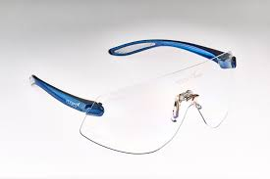
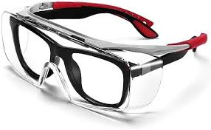
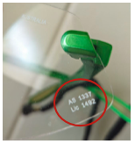
Personal Protective Equipment (PPE)
Stipulated PPE must be worn, or you will NOT be allowed to access the clinic.
This includes:
Impervious shoes
Comfortable, quality pair of safety glasses that comply with Australian standards: AS/NZS 1337:2012 Personal eye protection
Standard prescription glasses are not safety compliant and need to be worn with face shield or over-spec safety glasses.

Slide 21

Incident reporting
One of the reasons why we ask you to take things seriously
There is a lot of paperwork to fill out, but it is for your safety

Slide 22
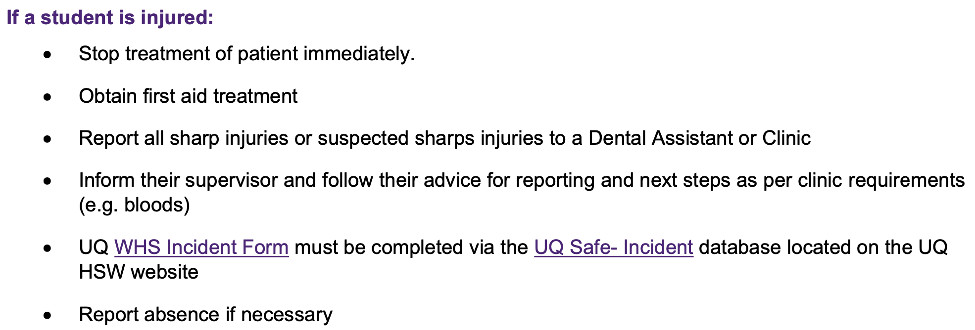
What constitutes as an incident?
What: all incidents and near misses
Occupational exposures -> sharps
Safety incidents -> violent or inappropriate patient behaviour
Patient incidents -> accidents involving the patient’s safety
Environment incident -> damage to property or equipment
Supervisor will guide you through

Slide 23
Reminders

Slide 24
Requisite items will be due!
Hand Hygiene Australia (HHA) module
Download the certificate of completion and upload to Blackboard
Pre-clinic laboratory induction
Complete the quiz (it is not hard, so don’t stress!)
These must be complete by the DUE DATE, else you cannot enter the clinic environments!
They WILL fall under as absences and contribute to your absence tally

Slide 25
Year Representatives:
Role of Year Reps (1x male, 1x female):
To serve as the student voice, for the good, the bad, but not the ugly, please.
The representatives liaise with me, as required.
Relaying information/updates on behalf of your class
To alert me if there are problems!!!
This isn’t supposed to take up much of your personal time
Don’t forget, this does not mean that you can’t approach me directly!

Slide 26


Thank you
Dr Thomas Kim | Lecturer
School of Dentistry
Thomas.kim@uq.edu.au
Connect with me
endo.yhk
Thomas-yhk

